Slide 1
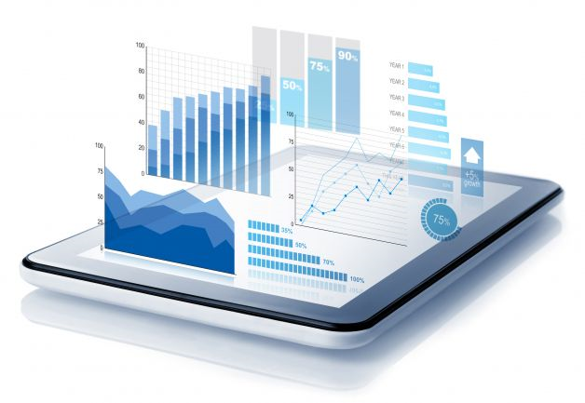




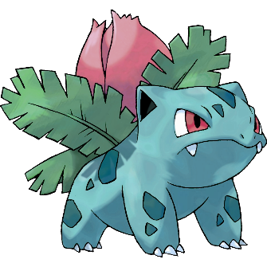
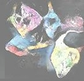


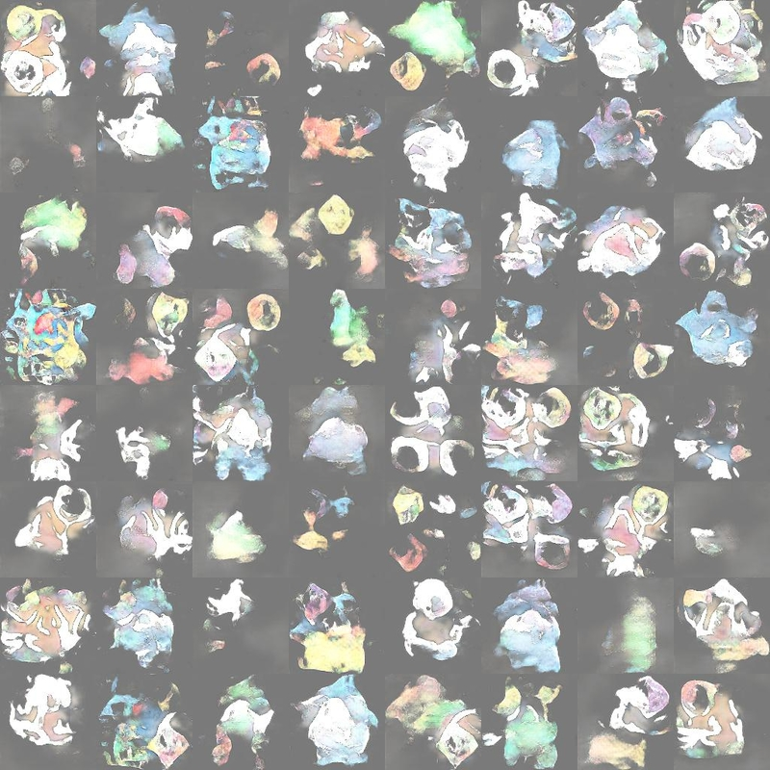


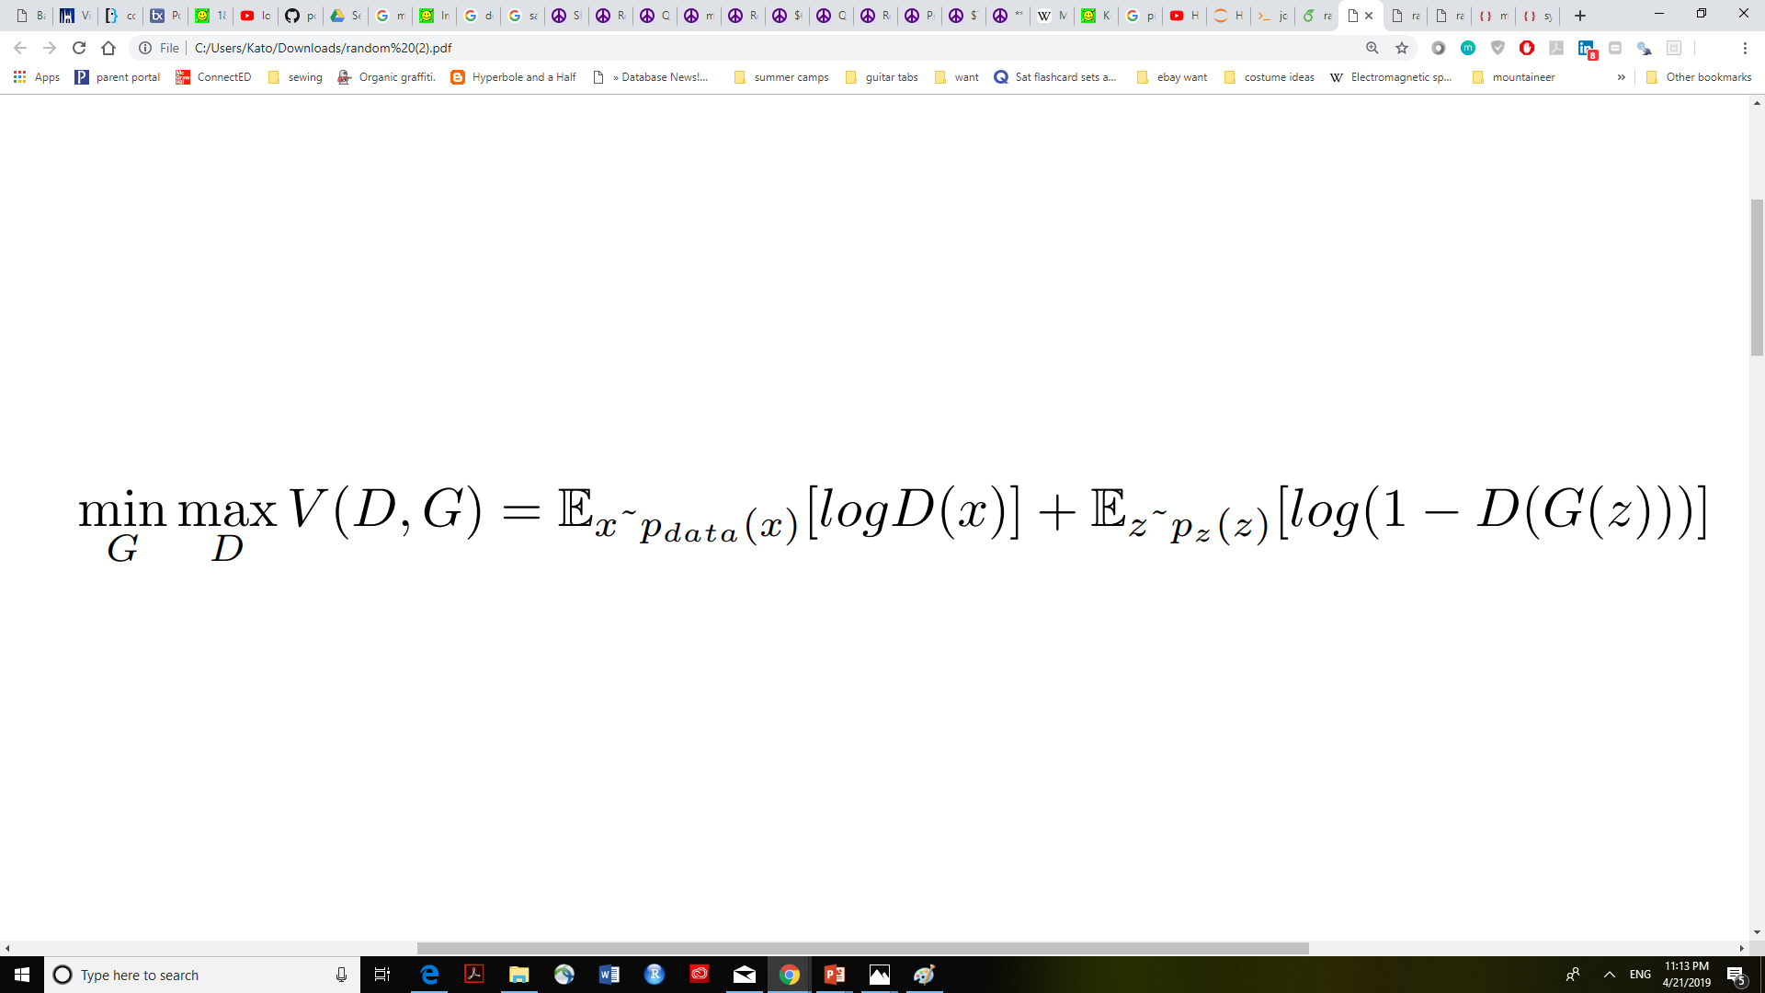
Real Data (x)
Can machines really think?
Artificial Intelligences (AIs) have “out-smarted” humans in Go, chess, Texas Hold’em poker, and more.^{[1]} But despite their abilities to analyze and strategize, a question arises on whether or not they truly understand their actions. This brings to mind Richard P. Feynman, 20th century physicist, who wrote:
“What I cannot create, I do not understand.”^{[2]}
Following this reasoning, we can answer the question of whether or not machines can really “understand” based on their ability to synthesize new material. In this project, we will explore machine understanding through image generation—in particular, by using Generative Adversarial Networks (GANs) to create new Pokémon.
Although the coloration mixtures and occasional patterns look like those of real Pokémon, the shapes of the Pokémon generated after 25,000 batch iterations do not resemble the real characters. Some of the generated images are just smudges of colors; others have distinct outlines, but resemble blobs or Rorschach tests more so than Pokémon.
z
(Random noise)
Synthetic Data G(z)
Generator
Discriminator
Transposed Convolution
Convolution
D(x), D(G(z))
(Probability images are real/fake)
Batch Normalization
Batch Normalization
We propose some potential changes to improve future versions of this PokéGAN:
⁕Larger Training Dataset; we found a Pokémon database with a larger sample, with different animation styles and angles for each Pokémon,^{[4]} as opposed to moxiegushi’s data, which only has one image per Pokémon. By using this kind of training data, we can provide the generator and discriminator with a more diverse view of Pokémon.
⁕Capsule Network; instead of using CNN, we could apply a Capsule Network. This allows the discriminator to identify features as individual “capsules” and identify directional relationships between the features, which together form larger “capsules.” Research shows applying Capsule Networks to GAN (i.e. CapsGAN) can generate more believable images compared to DCGANs.^{[5]}
⁕K-Beam Minimax; by using an ɛ-subgradient descent algorithm, we can simultaneously track K candidate solutions. This prevents the adversarial network from mode collapse, especially when backpropagation reaches local maxima/minima.^{[6]}
⁕Generative Adversarial Metric (GAM); we will use GAM to objectively compare the different GANs that we are considering.^{[5]}
ReLu Activation
Leaky ReLu Activation
1) Analyze an existing GAN that generates new Pokémon
2) Identify weaknesses in this GAN
3) Propose improvements for future versions
Fig. 1: PokéGAN structure. The black arrows indicate the general flow of the GAN. The blue and red show the direction of the generating and discriminating process. Images all taken from moxiegushi’s GitHub repository.^{[3]}
We utilize a GAN developed by moxiegushi as our base:^{[3]}
Wasserstein GAN (WGAN); prevents mode collapse by using the Wasserstein distance instead of Jensen-Shannon divergence to calculate similarity between real and generated data distributions.^{[1]}
Deep Convolutional Neural Network (CNN); the generator and discriminator are designed on a deep CNN. By using CNN, the discriminator can map its inputs’ features & better distinguish real from fake data.
Data; Pokémon images were taken from Bulbapedia.^{[4]}
Minimax; the generator and discriminator engage in an adversarial game. The generator creates synthetic data, which the discriminator attempts to classify as real or fake. This results in a “minimax” game as displayed in [Eq. 1] below.
[1] - H. Huang, P. S. Yu, and C. Huang. An Introduction to Image Synthesis with Generative Adversarial Nets. 2018. https://arxiv.org/pdf/1803.04469.
[2] - Caltech Archives. A Photograph of Richard P. Feynman’s blackboard.
[3] - Moxiegushi. pokeGAN. 2017a. https://github.com/moxiegushi/pokeGAN.
[4] - Bulbapedia. 2018. https://bulbapedia.bulbagarden.net/wiki/Main_Page.
[5] - A. Jaiswal, W. AbdAlmageed, Y. Wu, and P. Natarajan. CapsuleGAN: Generative Adversarial Capsule Network. 2018. https://arxiv.org/abs/1802.06167.
[6] - J. Hamm and Y-K Noh. K-Beam Minimax: Efficient Optimization for Deep Adversarial Learning. 2018. https://arxiv.org/pdf/1805.11640.
Fig. 2: PokéGAN generated images after 5,000 epochs (25,000 batch iterations total). Image taken from moxiegushi’s GitHub repository.^{[3]}

